Slide 1
Clustering
Nithin Thomas

Slide 2

Content of Presentation
Description of the Analysis
Cluster identification using Elbow Methods
Cluster identification using Silhouette Methods
Insights from the Newly Created Clusters

Slide 3
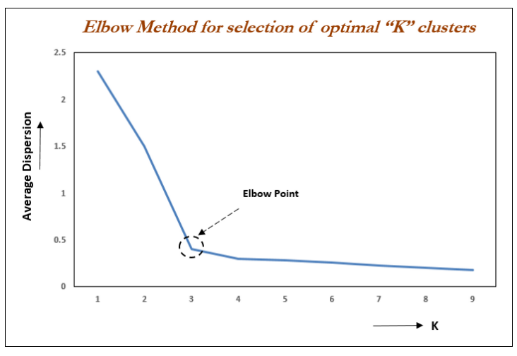
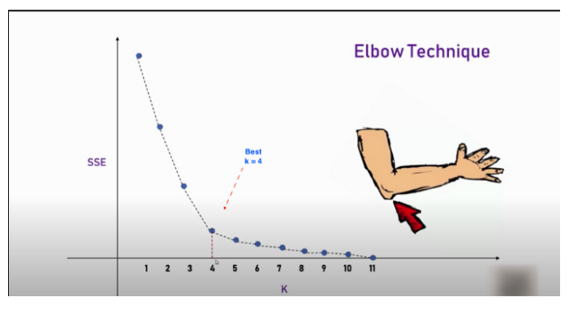
Description of the Analysis
Elbow Method
A fundamental step for any unsupervised algorithm is to determine the optimal number of clusters into which the data may be clustered.
The Elbow Method is one of the most popular methods to determine optimal value of k.
The elbow method helps to select the optimal number of clusters by fitting the model with a range of values for K. If the line chart resembles an arm, then the “elbow” (the point of inflection on the curve) is a good indication that the underlying model fits best at that point
The value of k at which improvement in distortion declines the most is called the elbow, at which we should stop dividing the data into further clusters.
Figure 1.1 Elbow Method

Slide 4
Description of the Analysis
Steps involved in Elbow Method:
Compute the clustering algorithm by varying the value of k.
Calculate the value of WCSS with respect to each k.
Plot a graph of WCSS v/s number of clusters.
Locate the values near the bend region (knee) of the plot which is considered as the appropriate number of clusters needed.
We can take this value to continue with the clustering.
Note:-
When using elbow method, look for the point from where the SSE plot starts looking linear. In other words, the decrease in Average Dispersion is not much after that point.

Slide 5
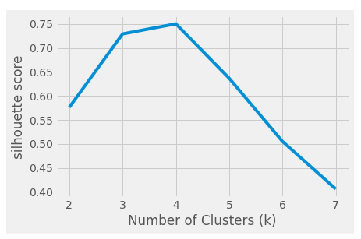
Description of the Analysis
Silhouette Method
The silhouette value is a measure of how similar an object is to its own cluster (cohesion) compared to other clusters (separation).
The value of the silhouette ranges between [1, -1], where a high value indicates that the object is well matched to its own cluster and poorly matched to neighboring clusters.
For each k-Means clustering model represent the silhouette coefficients in a plot and observe the fluctuations and outliers of each cluster.
Always choose Number of Cluster(k) corresponding to highest silhouette score(for example here from the figure, we choose k=4)
Figure 1.2 Silhouette Score

Slide 6
Description of the Analysis
Steps involved in Silhouette Method
Compute the clustering algorithm by varying the value of k.
Calculate the silhouette coefficients with respect to each k.
Plot a graph of silhouette coefficients v/s number of clusters.
Take the value for k with maximum silhouette coefficient, which is considered as the best value of k for clustering.
We can take this value to continue with the clustering.
Note:-
Elbow and Silhouette methods are used to find the optimal number of clusters. Ambiguity arises for the elbow method to pick the value of k.
Silhouette analysis can be used to study the separation distance between the resulting clusters and can be considered a better method compared to the Elbow method.

Slide 7
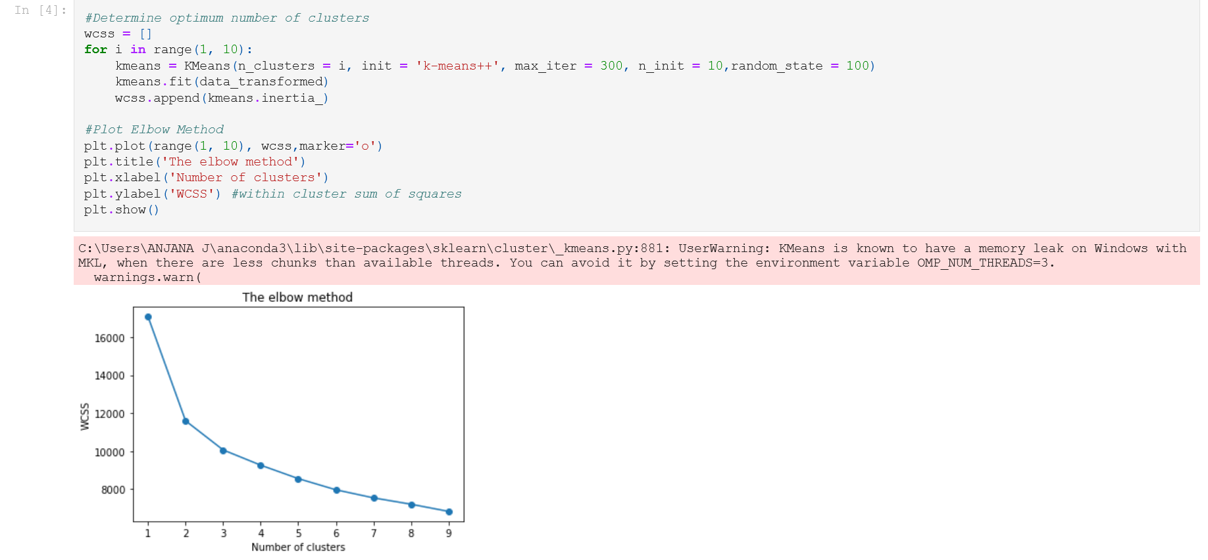
Cluster identification using Elbow Methods
From graph, When the value of k is 1, the within-cluster sum of the square(WCSS) is high.
As the value of k increases, the within-cluster sum of square value is decreasing.
When we examine the graph carefully, it is found that at some point our graph will decrease abruptly. That point will be considered as a value of k.
To determine the optimal number of clusters, we have to select the value of k at the “elbow” i.e., the point after which the distortion/inertia start decreasing in a linear fashion. Thus, for the given data, we conclude that the optimal number of clusters for the data is 2 and 3.
In this case, the graph does not look like an elbow, this makes things very difficult to choose the value of k due to multiple optimum points in the elbow. Thus, we would be conducting Silhouette method to verify.
Figure 1.3 Elbow Method Output

Slide 8
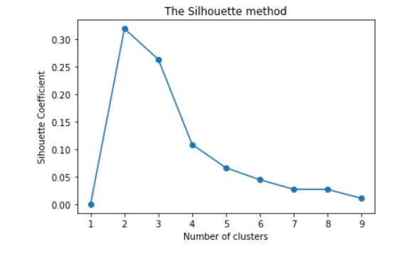
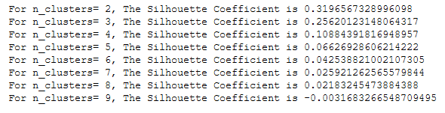
Cluster identification using Silhouette Methods
Here we are considering no. of clusters between 2 and 9
From the graph, it is evident that as the number of cluster increases the silhouette coefficient increases and then decreases sharply.
From the graph, it is clear that when no of clusters = 2, silhouette coefficient is high and hence we choose number of clusters as 2.
Figure 1.4 Silhouette Method Graph Output
Figure 1.5 Silhouette Coefficient Output

Slide 9
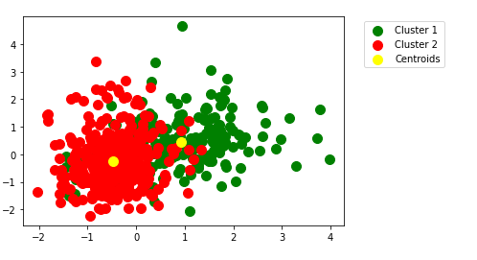
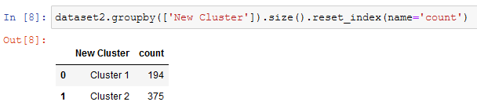
Insights from the Newly Created Clusters
From the figure, it is evident that data points in Cluster 1 is more dispersed from the centroid
From the figure, it is also evident that data points in Cluster 2 is more concentrated around the centroid.
Here from the figure, some of the data points which is actually close to Cluster 2 is wrongly categorized as Cluster 1, which affects the accuracy of the identified centroids.
Here, Cluster 2 has more number of datapoints compared to Cluster 1.
Outliers
Figure 1.6 Identified Cluster and Centroids
Figure 1.7 Cluster Counts

Slide 10


